Slide 1
Build, Train, and Deploy TensorFlow models with Amazon SageMaker
Rama Thamman
Vikrant Kahlir

Slide 2
Agenda
Amazon SageMaker overview
Q & A
Setup for Workshop
Hands-on Workshop modules

Slide 3
Amazon SageMaker overview

Slide 4

Amazon SageMaker
A managed service that provides the quickest and easiest way for data scientists and developers to get
ML models from idea to production.

Slide 5
Components of Amazon SageMaker used in the Workshop
UX
Training
Hosting
Amazon’s fast, scalable algorithms
BYO script for ML frameworks
BYO algorithm
Automatic Model Tuning

Slide 6
Amazon SageMaker is Modular
Examples of adapting SageMaker to your workflow:
UX: Using a SageMaker notebook is convenient, but not necessary. Perhaps you prefer RStudio running on EC2 instead; that’s fine! Or scripts, or CLI . . . .
Training: SageMaker automates setting up and launching training clusters, but you can continue using your own training cluster.
You also can take a SageMaker-trained model elsewhere. . . .
Hosting: if you’re using your own training cluster, you can bring your model trained there into SageMaker hosting.

Slide 7
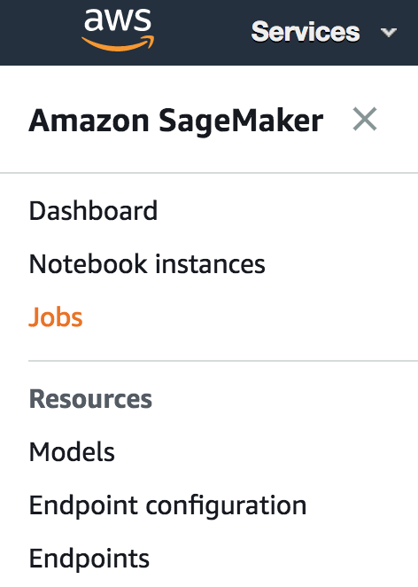

UX Choices
Use SageMaker‘s hosted Notebook Instances...
… or Apache Spark through EMR and the SageMaker Spark SDK...
... or SageMaker‘s Console for a point and click experience...
... or your own device (EC2, laptop, etc.)

Slide 8

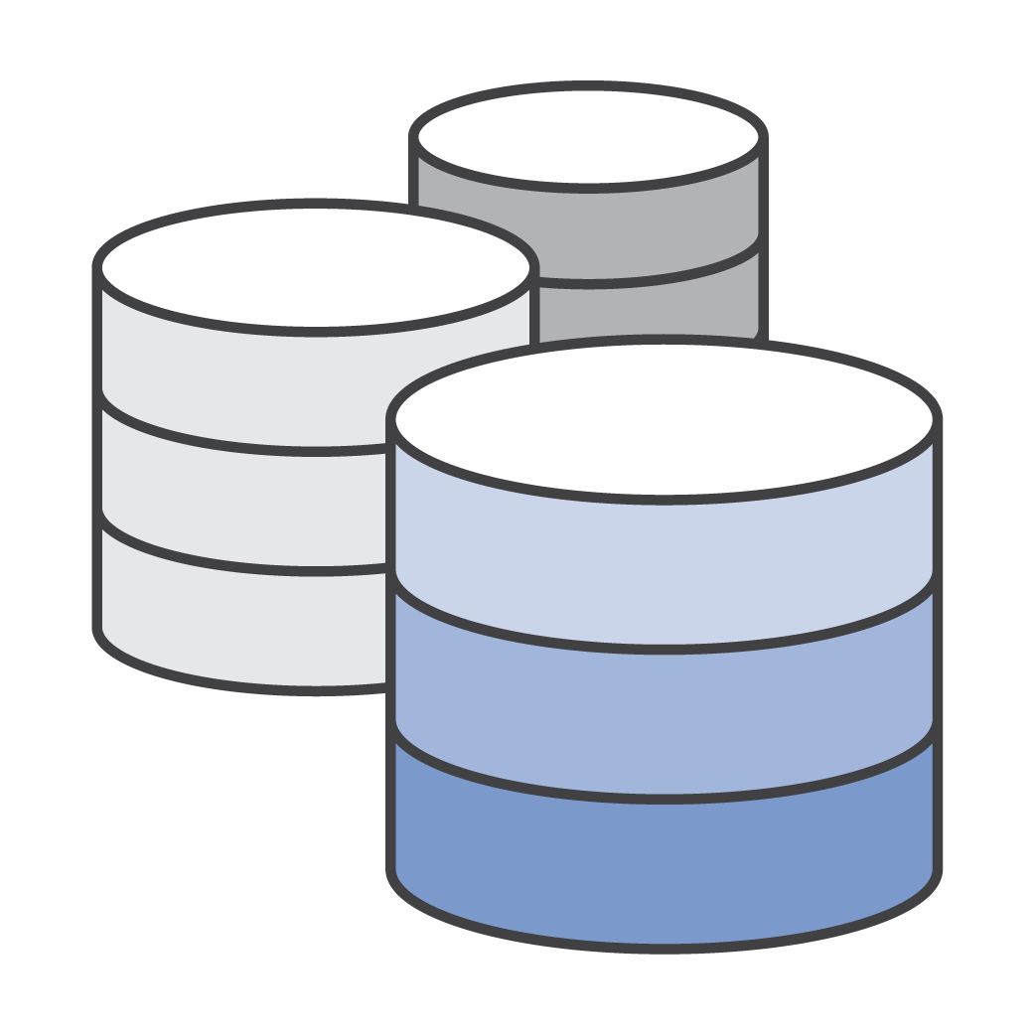
Training: Automated Hardware/Cluster Management
Zero setup
Distributed Training
Docker / ECR under the hood (but you don’t need to touch it)
Deploy trained models locally, to SageMaker, or to edge devices such as DeepLens

Slide 9

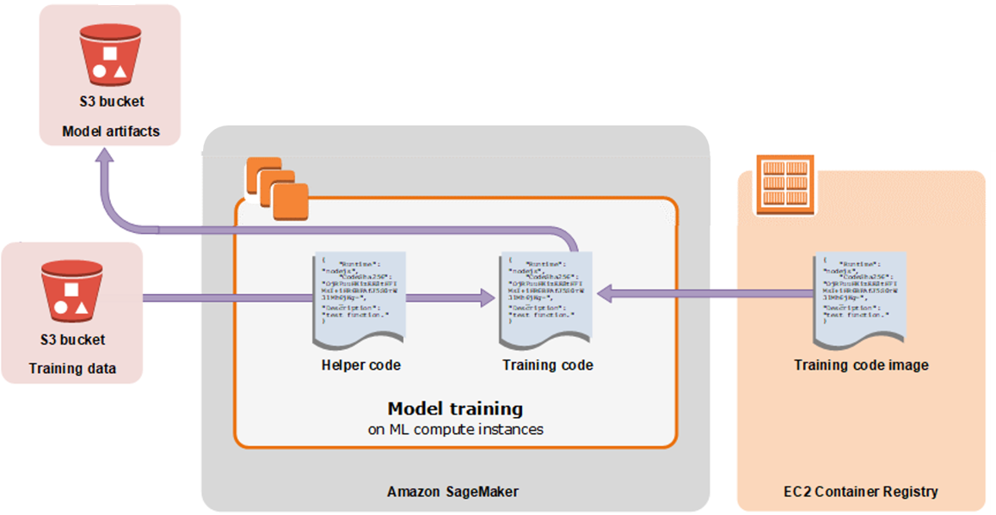
Training: data into S3, models out to S3, run anywhere with Neo
SageMaker Neo

Slide 10
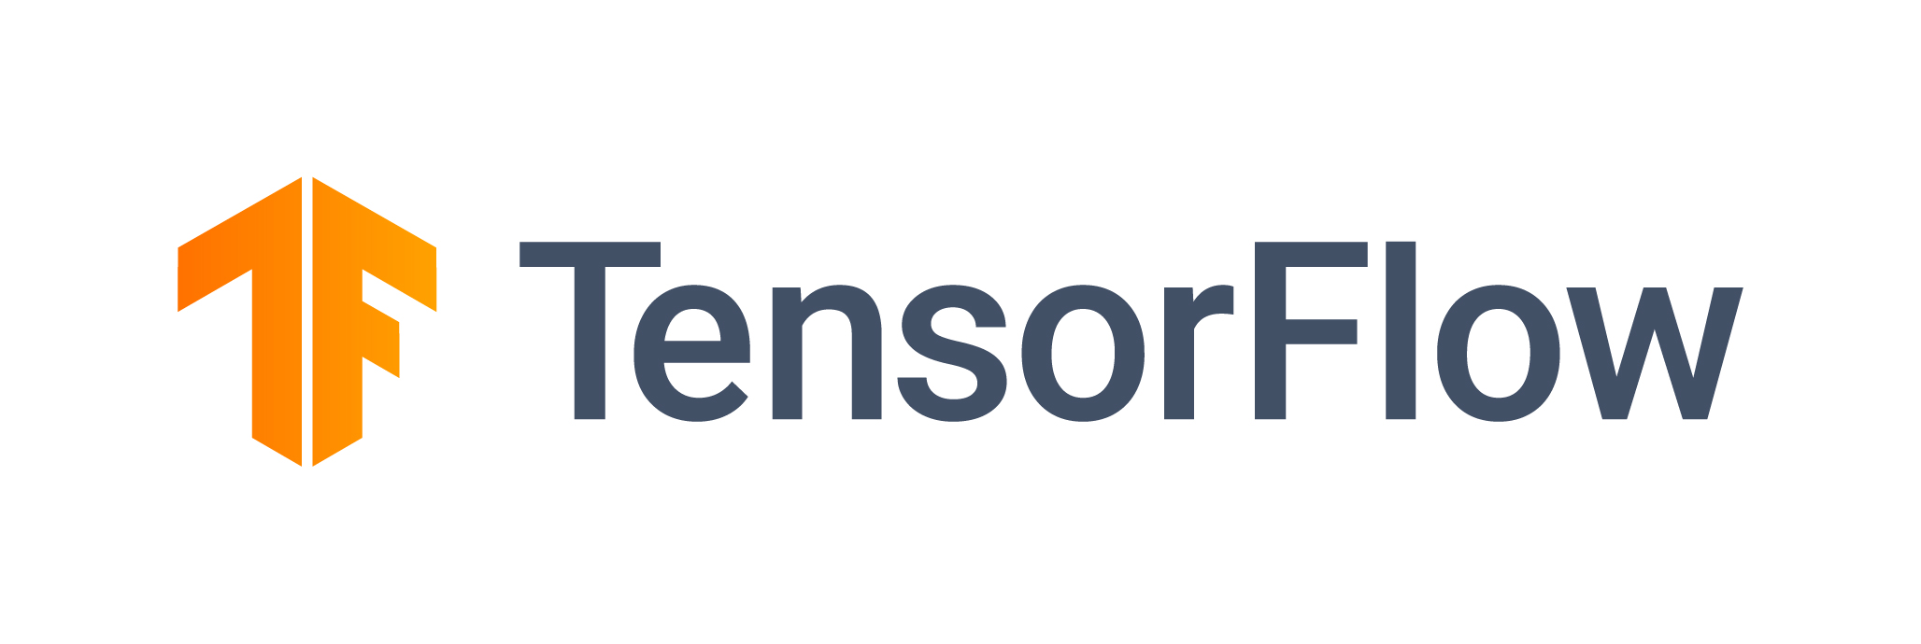



Training: BYO Script Mode with Prebuilt Containers
Sample your data…
… explore and refine models in a Notebook Instance
Use the same code to train on the full dataset in a cluster of GPU instances…
… deploy to production

Slide 11



Training: Bring Your Own Algorithm (BYOA) using Docker
etc.
Amazon ECR
Pick your preferred technology...
... add algorithm code to a Docker container...
... publish image to ECR

Slide 12






Hosting: Automated Model Deployment & Autoscaling
One step deployment
Fast, reliable
real time and batch inference
A/B testing
built-in
Use your own model
Optimize with Neo and Elastic Inference

Slide 13



















There is more to SageMaker & the AWS ML Stack:
Vision
Speech
Language
Chatbots
Forecasting
Recommendations
AI SERVICES
REKOGNITION
IMAGE
REKOGNITION
VIDEO
TEXTRACT
POLLY
TRANSCRIBE
TRANSLATE
COMPREHEND
LEX
FORECAST
PERSONALIZE
AMAZON SAGEMAKER
ML SERVICES
BUILD
TRAIN
DEPLOY
Pre-built algorithms & notebooks
One-click model training & tuning
One-click deployment & hosting
Data labeling (GROUND TRUTH)
Optimization (NEO)
Algorithms & models (AWS MARKETPLACE
FOR MACHINE LEARNING)
Reinforcement learning
Frameworks
Interfaces
Infrastructure
ML FRAMEWORKS & INFRASTRUCTURE
EC2 P3 & P3N
EC2 C5
FPGAs
GREENGRASS
ELASTIC INFERENCE

Slide 14
Q&A

Slide 15
Getting Started on the Workshop

Slide 16
Workshop Options
There are three main modules in this workshop. Modules are independent and can be completed in any order :
NLP Use Case – Sentiment Analysis: train a textCNN to classify movie reviews as positive or negative, and perform batch inference on a set of reviews.
Structured Data Use Case – Boston Housing: while training a regression MLP to predict house prices, use Automatic Model Tuning to find the best hyperparameters.
Computer Vision Use Case – Image Classification: train a CNN from scratch to classify images using a cluster of machines and Horovod; deploy a real time endpoint with Elastic Inference for lower cost GPU-accelerated predictions, and also perform batch inference on PNG images with SageMaker-provided data transform functionality.
Notes:
Add PS

Slide 17
Workshop Setup
https://dashboard.eventengine.run
Notes:
Go to this URL in your browser

Slide 18
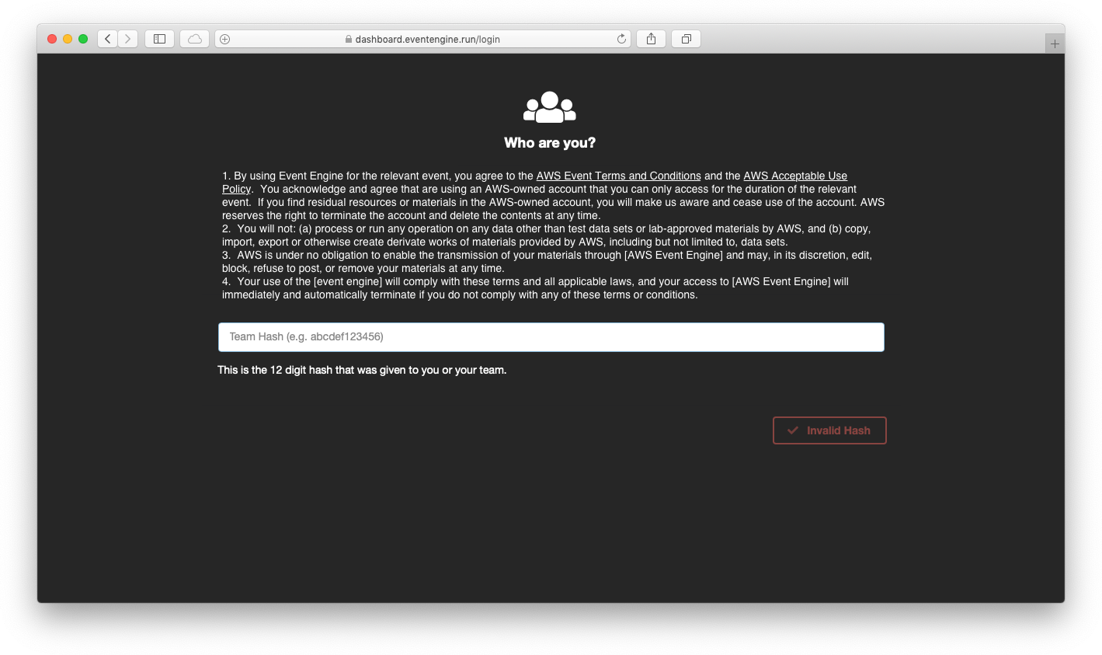
Notes:
You should be given a 12-character “hash” – this might be individual to you, or your team or group may share one hash.

Slide 19
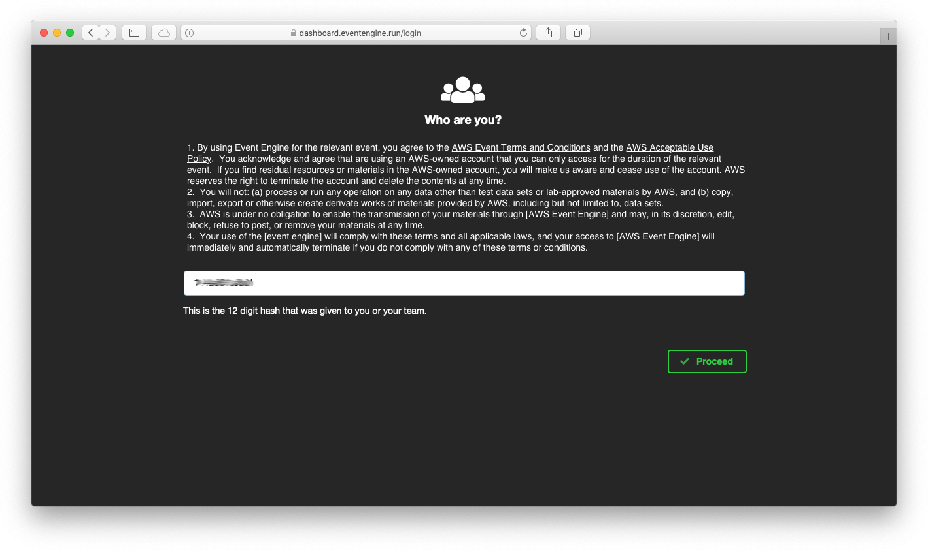
Notes:
Please read and understand the terms and conditions.

Slide 20
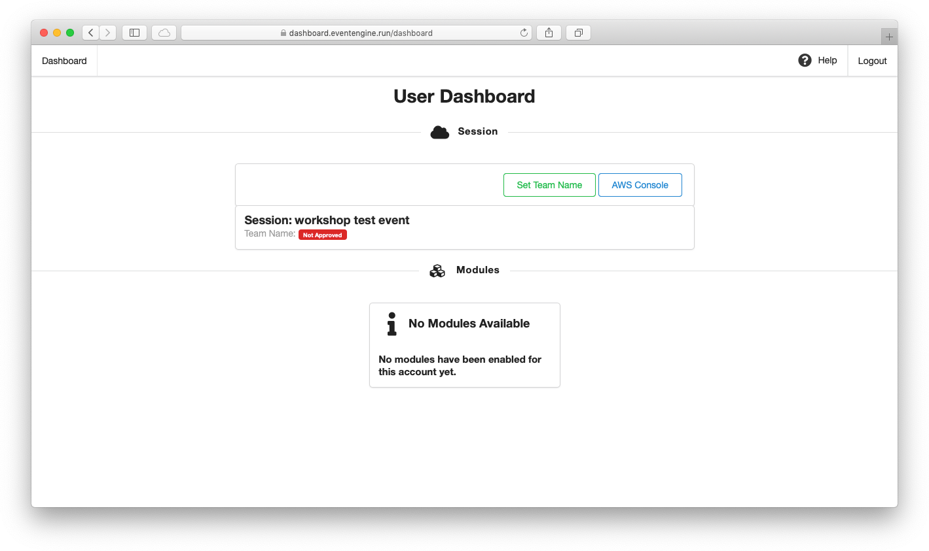
Notes:
You may have the option to set a Team Name. You do not need to do this, but you can if you like. It won’t affect the rest of the workshop.

Slide 21
Notes:
Click the AWS Console link to login to the AWS account you’ll use in today’s event

Slide 22
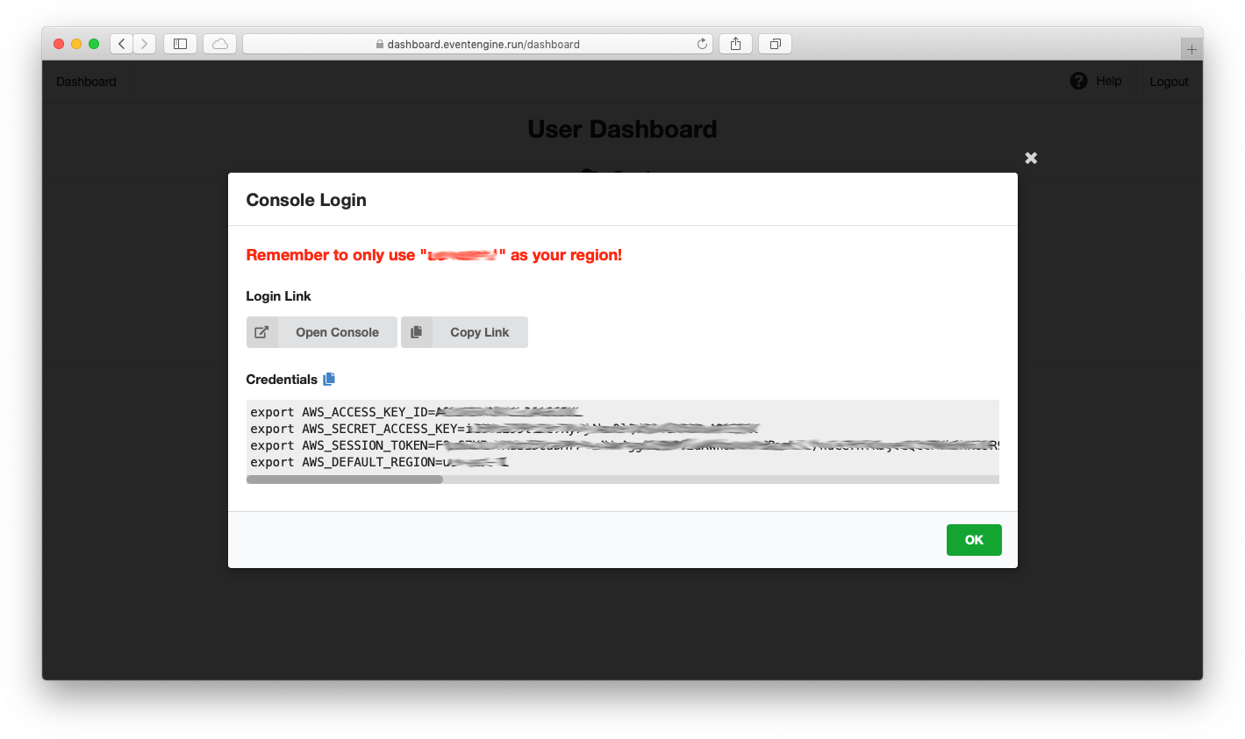
Windows users: use set or Set-Credential instead of export
Notes:
Please note the region that the event is using. Only actions in this region are allowed.
Click the Open Console button to open the AWS Console. You can also copy and past the Credentials into your terminal window if you need to use the AWS CLI
Windows users, use the SET command or the Set-Credential cmdlet rather than EXPORT

Slide 23
Thank you!

